Slide 1
The Mirror Effect in SDT
Not another Recognition Memory study
PAPIIT IN307214

Slide 2
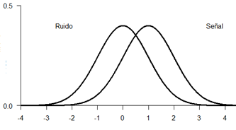
One single problem…
Is that the sound of a predator approaching?
Is this food eatable?
Is my mom mad at me?
Is there a bomb in this bag?
Noise
Signal
Is the target stimulus present?

Slide 3
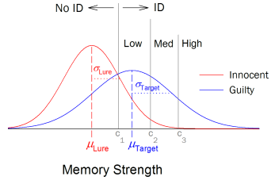
The Reliability of Eyewitness Identifications from Police Lineups
Wixted, Miickes, Dunn, Clark & Wells, 2016

Slide 4
Recognition Memory
Study phase
Recognition Task
Incidental
Intentional
Have I seen this stimulus before?

Slide 5
Procedures
1. Yes|No Task
Have you seen this stimulus before?
2. Confidence Rating
How confident are you about your answer?
0 | 1 | 2 | 3 | 4 | 5
HIGH New | MEDIUM New | LOW New | LOW Old | MEDIUM Old | HIGH Old

Slide 6
Mirror Effect
“If there are two classes of stimuli, and one is more accurately recogized than the other, then the superior class is both more accurately recognized as old when old and also more accurately recognized as new when new (…) means that the greater efficiency in recognizing is always twofold”
(Glanzer, Adams, 1990)

Slide 7
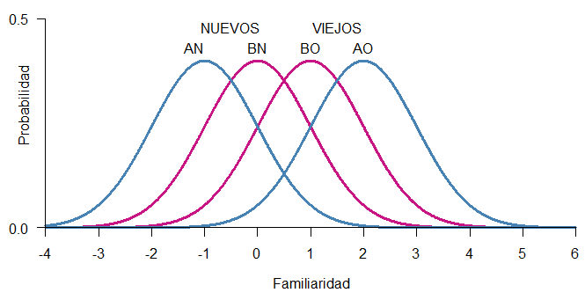
Mirror Effect
The greater efficiency in recognizing is always twofold.

Slide 8


Evidence
Yes/No
Procedure
Rate
Confidence
Rating
Mean
2AFC: Preferences

Slide 9
Multiplicity
“The experimenter can produce as many separate mirror orders within a single data set as wished. All that has to be done is to impose effective variables factorially on the presented material and have a sufficient number of items in the study list.”
Extensiveness
“When two variables are used in a single experiment (…) produce an array of eight underlying distributions in mirror order”.

Slide 10
The Mirror Effect has only been studied within Recognition Memory.
Can we find the Mirror Effect in other areas where SDT has been applied?

Slide 11
Experiments

Slide 12
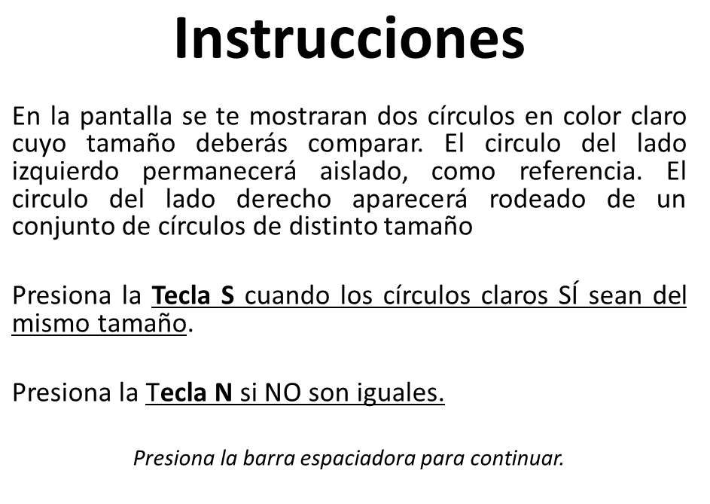

Slide 13
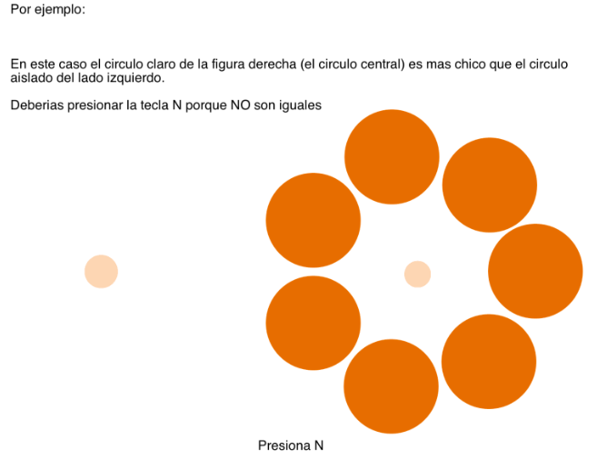

Slide 14
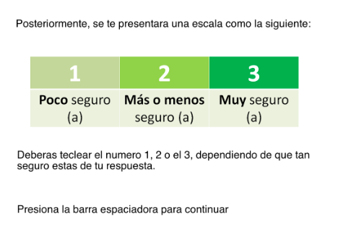

Slide 15
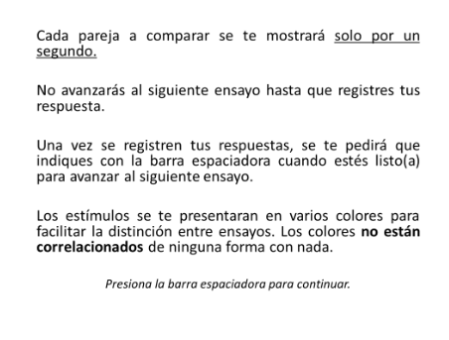

Slide 16
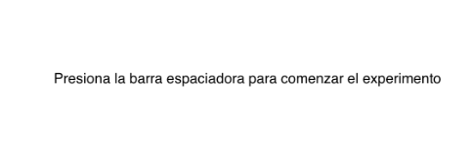

Slide 17
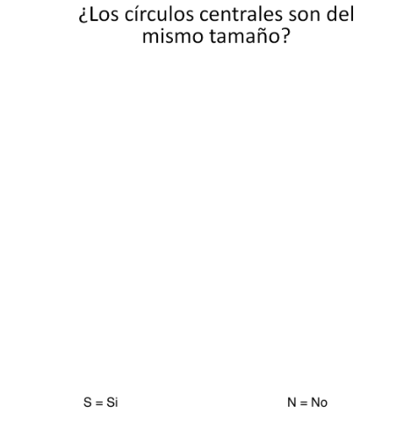
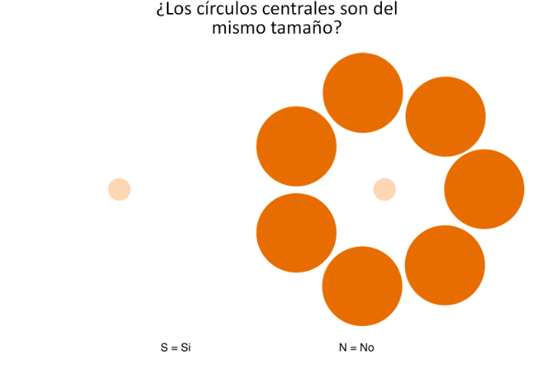

Slide 18
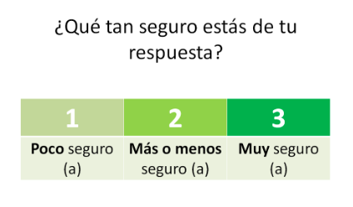

Slide 19
Looking for the Mirror Effect: A & B
2 or 3 external circles
7 or 8 external circles
A
B

Slide 20
O
3
2
U
3
O
2
2.5
3
U
O
2
2
2
U
3
O
1.5
2
U
3
O
2
1
U
3

Slide 21
A: Fewer External Circles
B: More external circles
16 pairs (signal)
16 pairs (noise)
32 trials
320 type A trials
16 pairs (signal)
16 pairs (noise)
32 trials
320 type B trials
64 trials
x10
5 different colors
2 per color
Counterbalancing

Slide 22
Two Experiments
Experiment 1:
Just one Ebbinghaus Illusion
Experiment 2:
Two Ebbinghaus Illusions
160 AS
160 AN
160 BS
160 BN
Same procedure
160 AS
160 AN
160 BS
160 BN
Same procedure

Slide 23
Data!
Individual cases

Slide 24
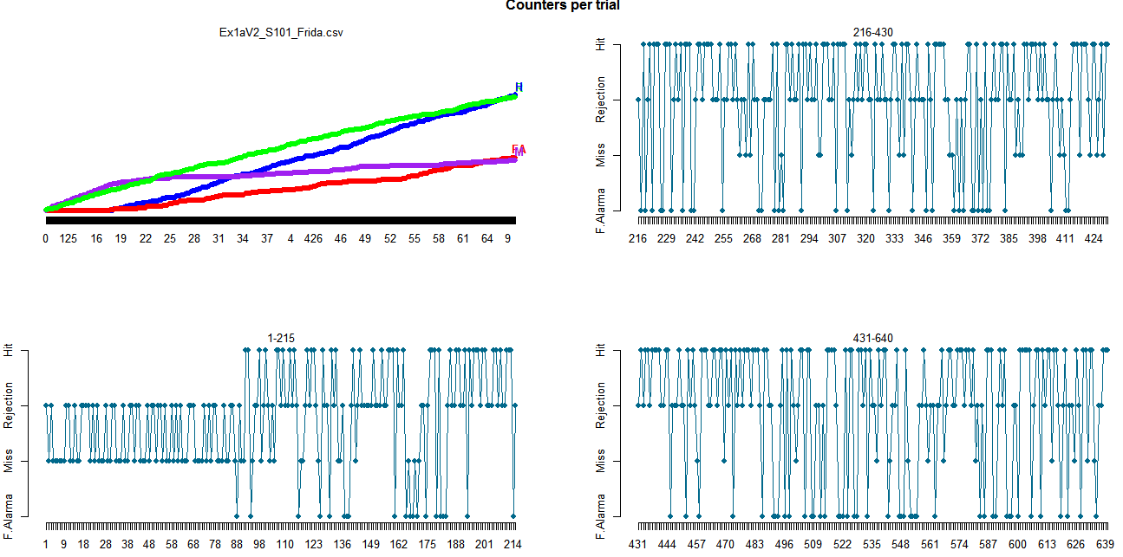
1st: Did our participants pay attention to the task?

Slide 25
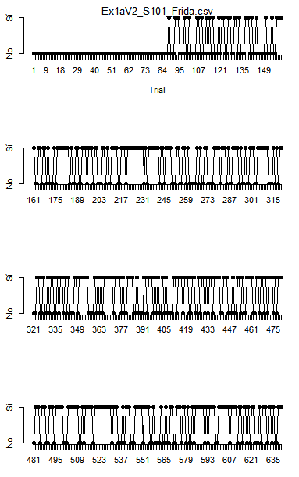

Slide 26
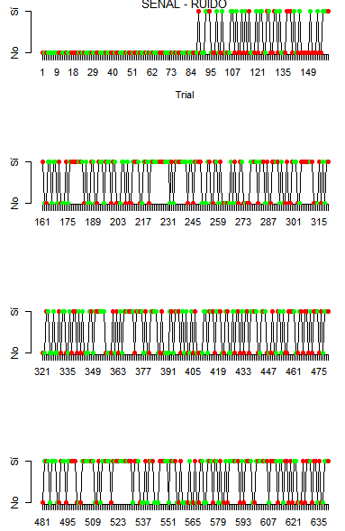
Signal - Noise

Slide 27
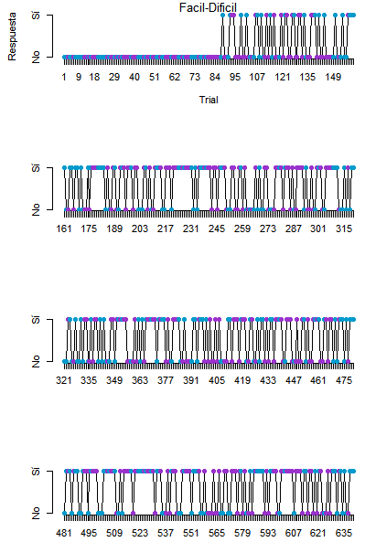
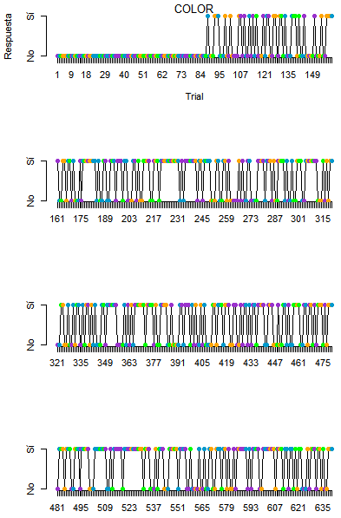

Slide 28
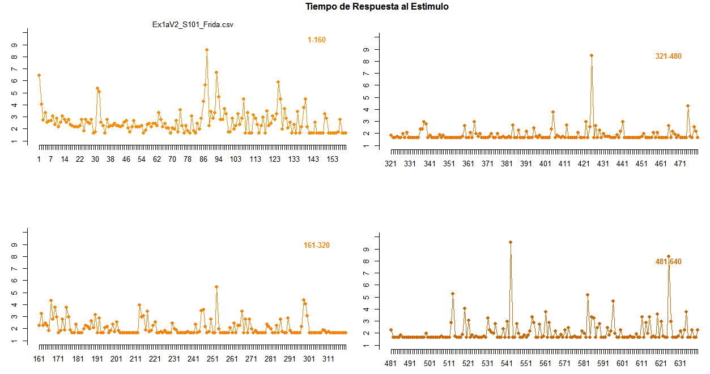

Slide 29
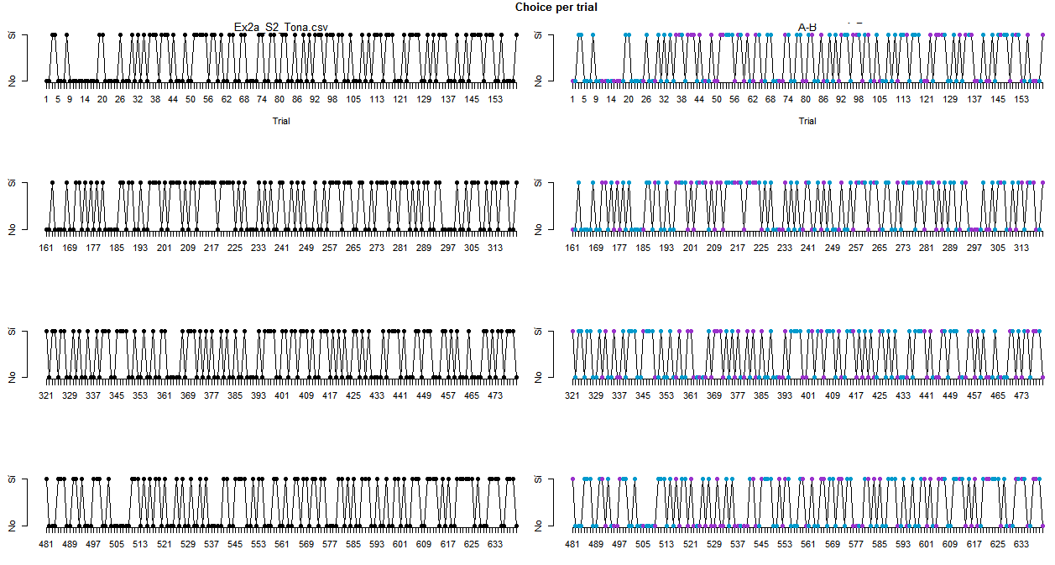

Slide 30
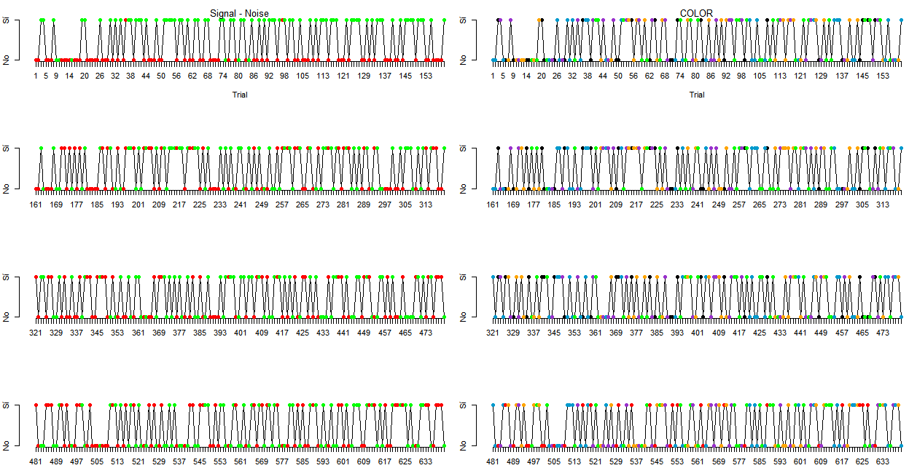

Slide 31
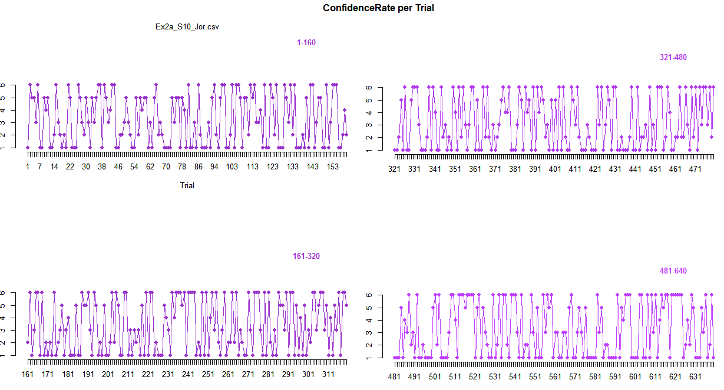
Confidence Rating

Slide 32
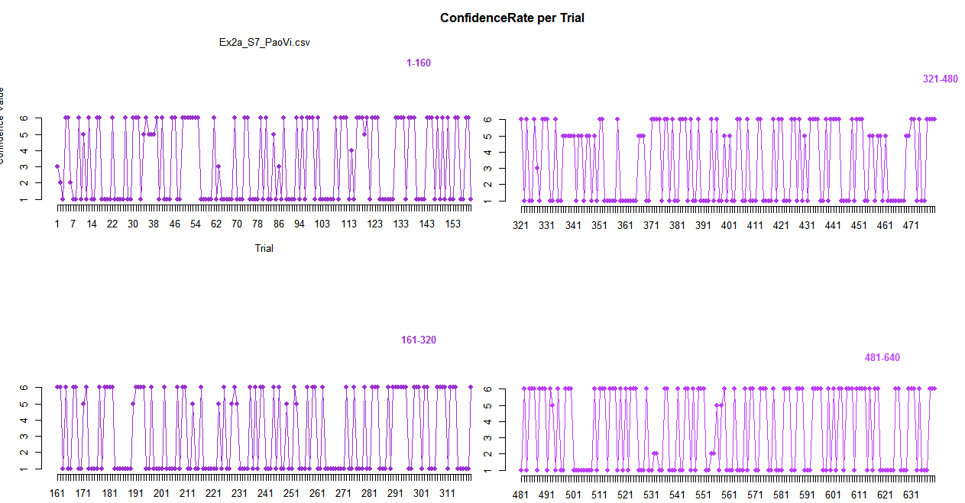
Confidence Rating

Slide 33
2nd: Exploring Sequential effects

Slide 34
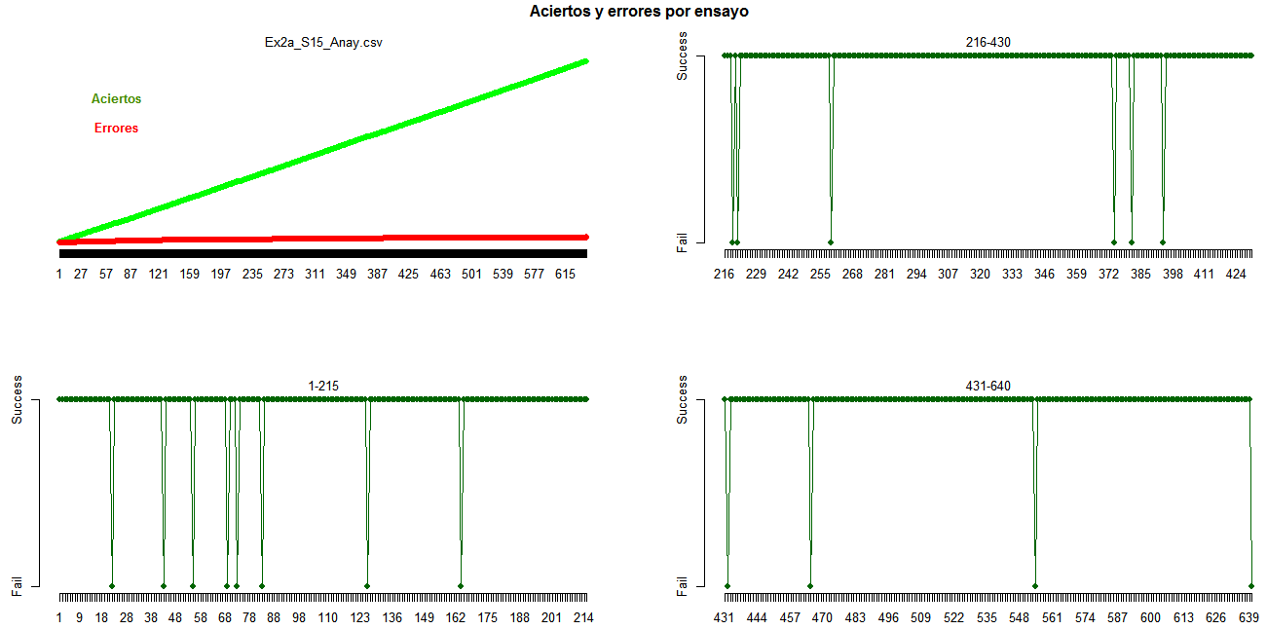
2nd: Exploring Sequential effects

Slide 35
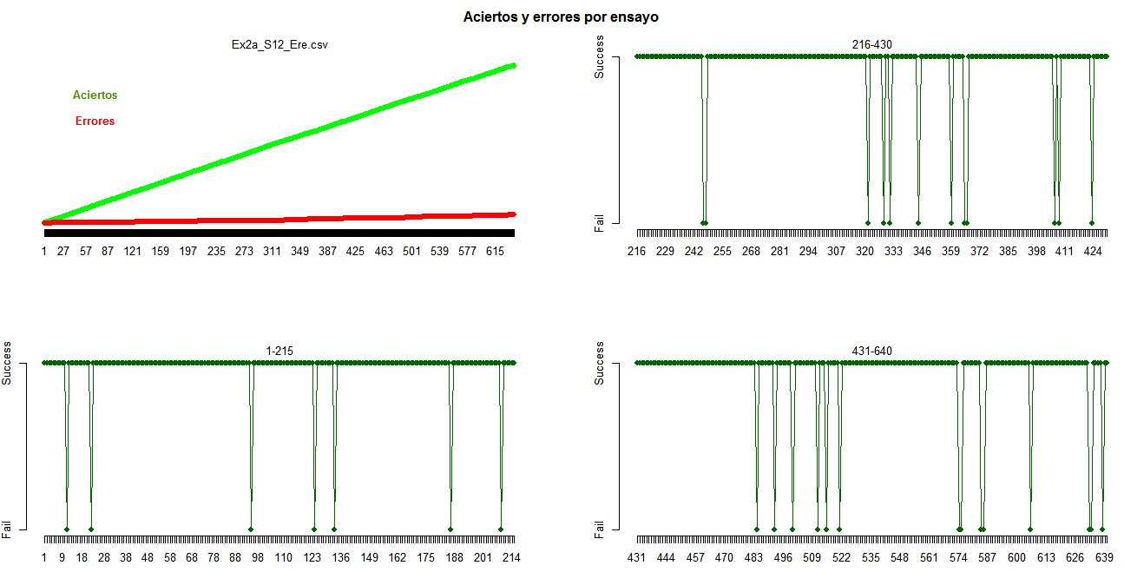

Slide 36
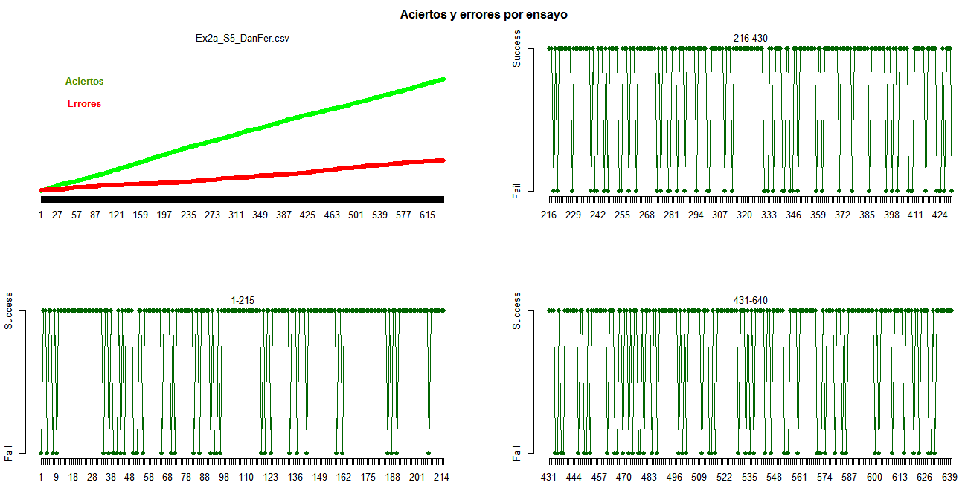

Slide 37
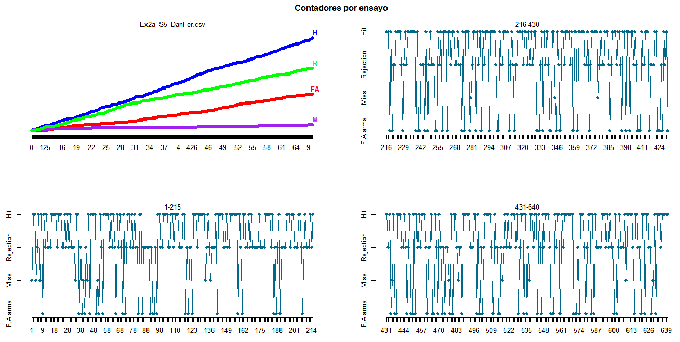

Slide 38
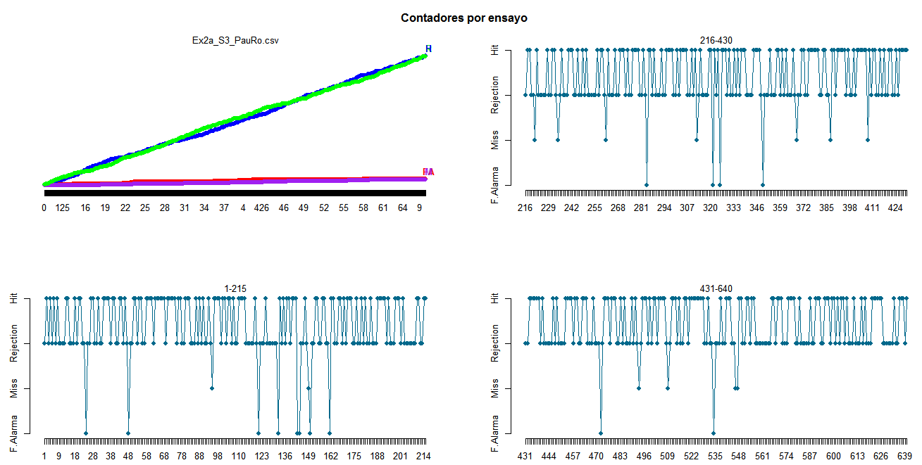

Slide 39
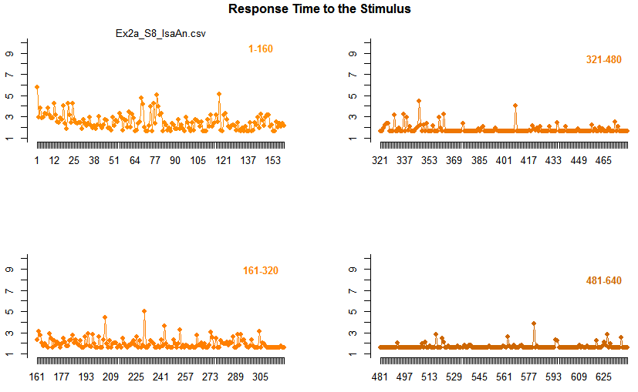

Slide 40
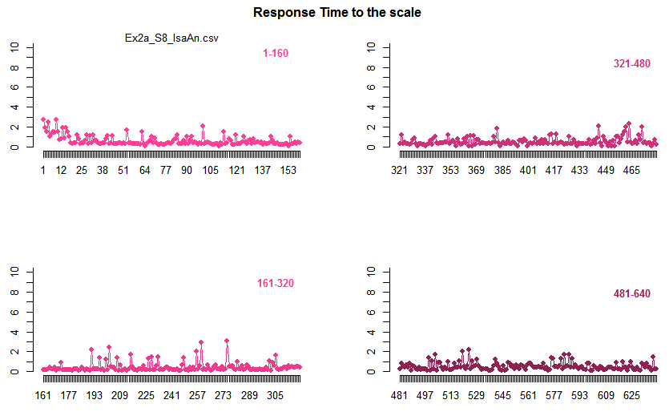

Slide 41
3rd: Exploring Correlations!

Slide 42
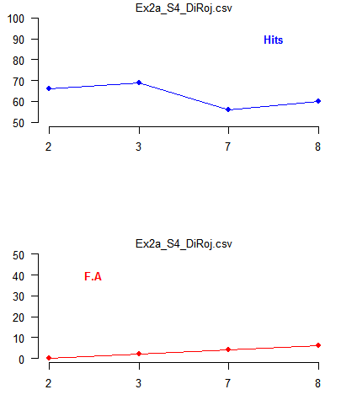
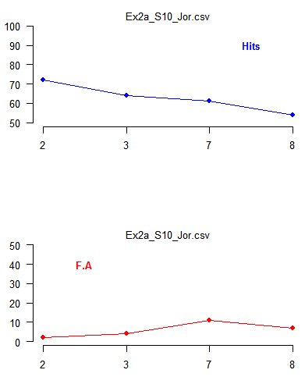
3rd: Exploring Correlations!

Slide 43
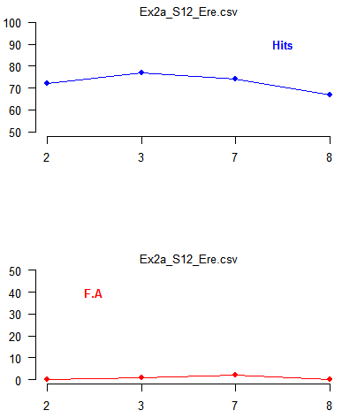
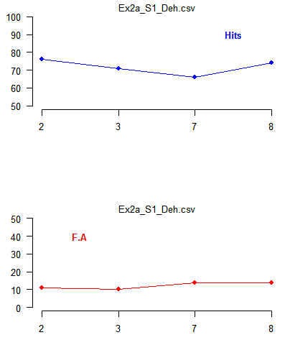

Slide 44
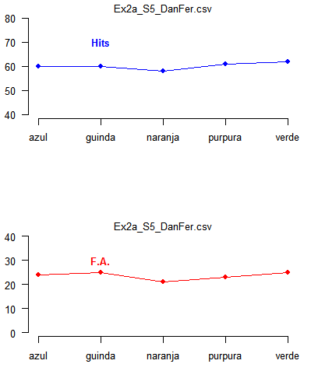
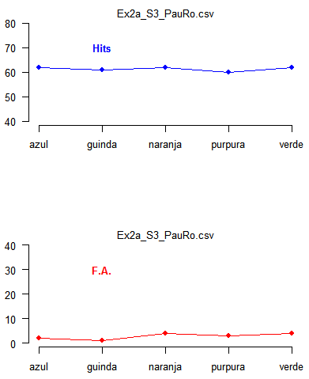

Slide 45
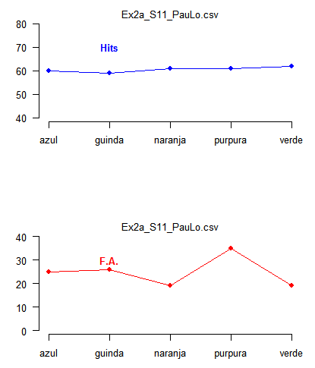
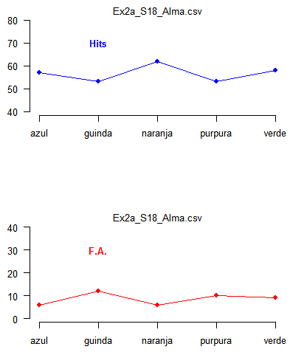

Slide 46
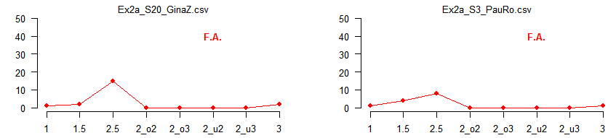
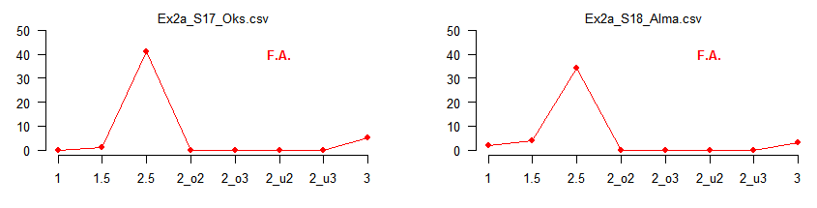

Slide 47
4th: Evaluating the pattern

Slide 48
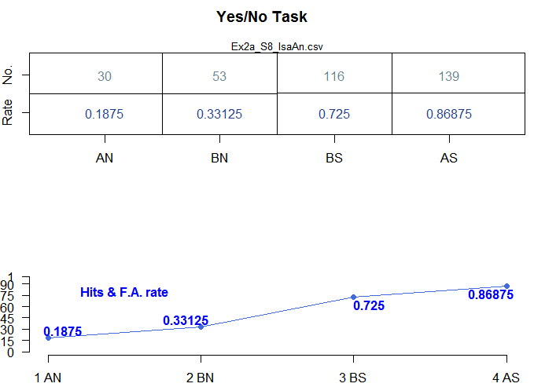
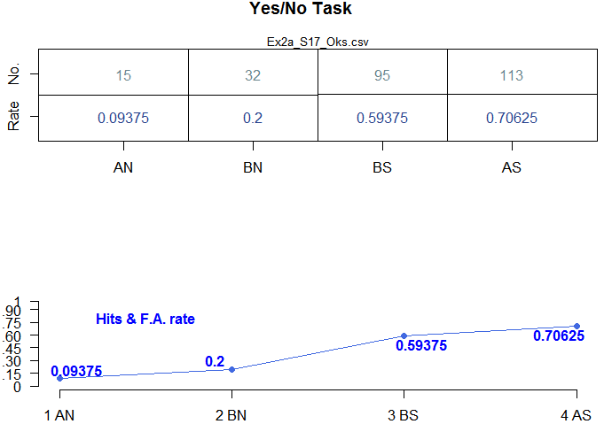
4th: Evaluating the pattern

Slide 49
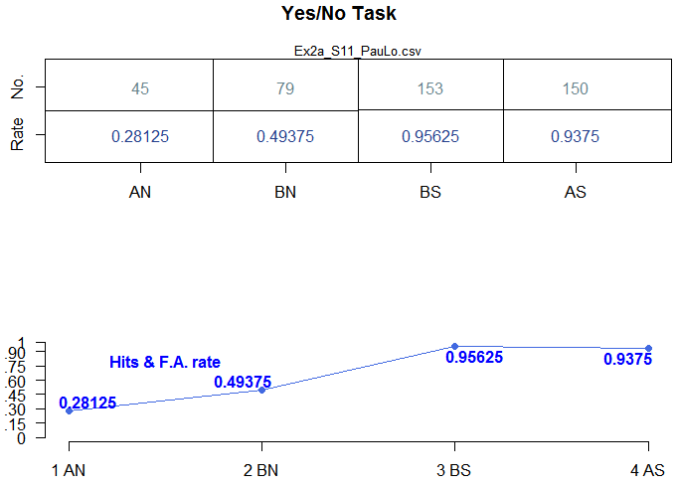
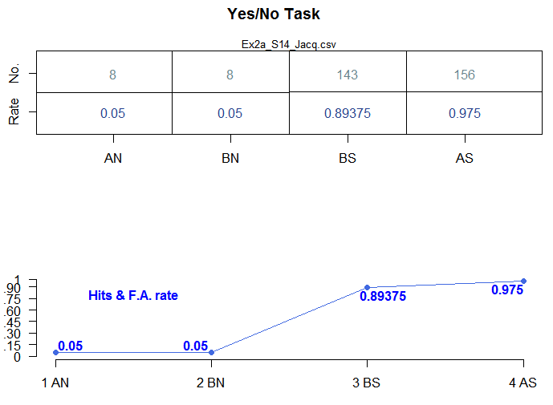

Slide 50
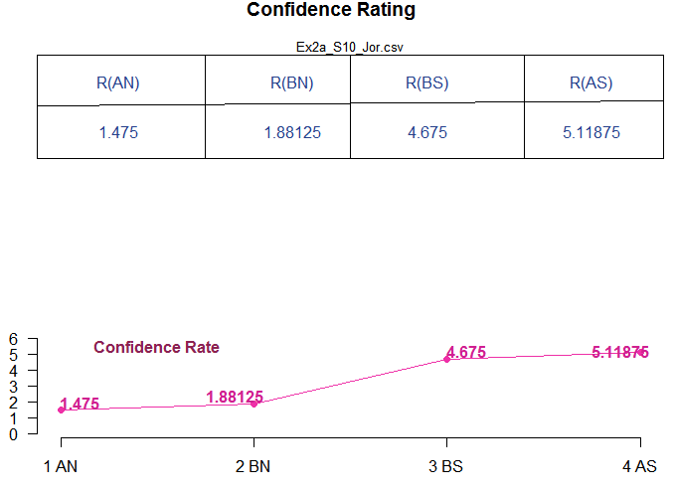
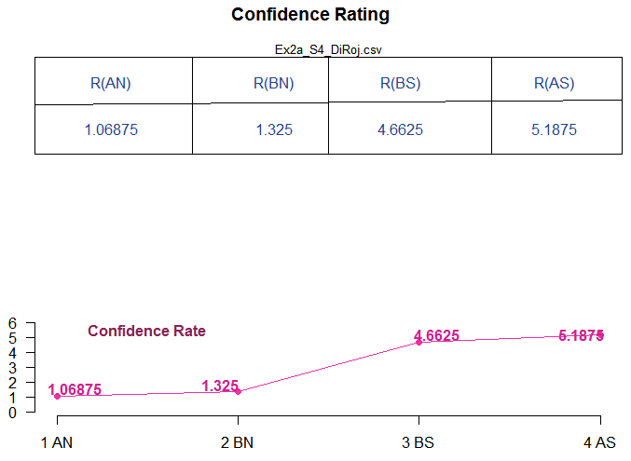

Slide 51
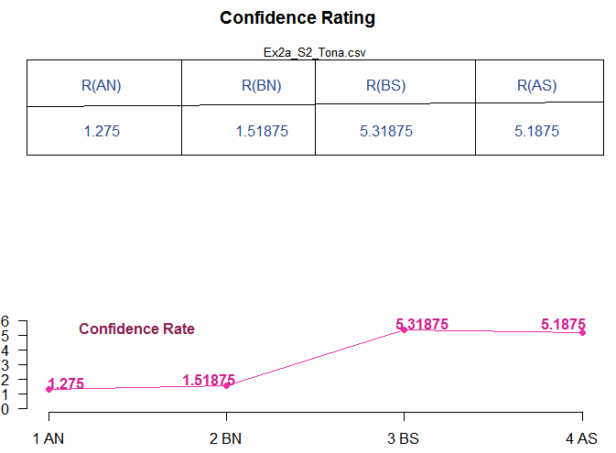
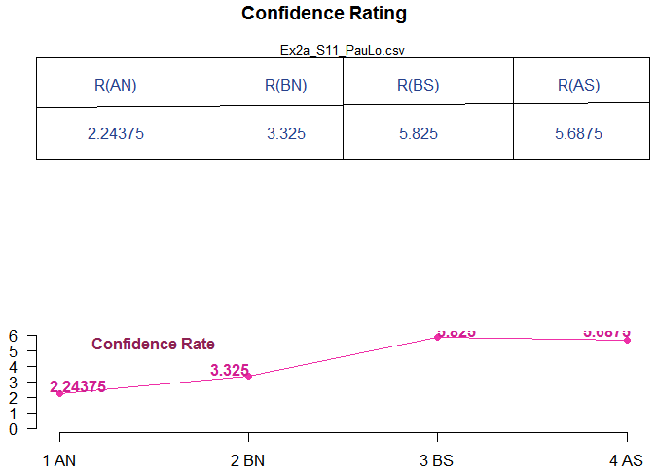

Slide 52
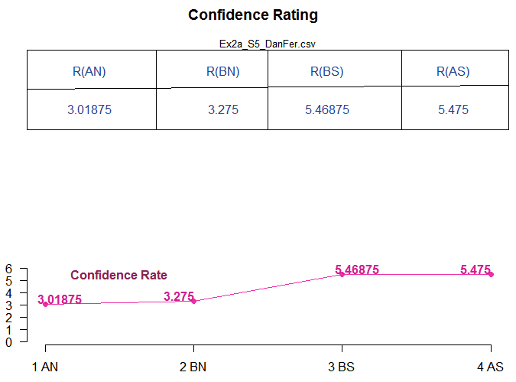
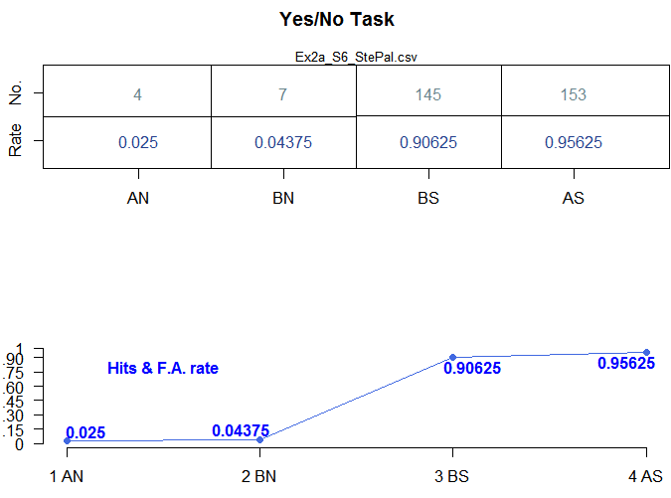
Ambiguity

Slide 53
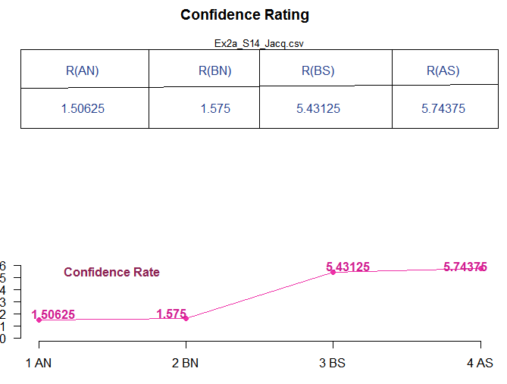

Slide 54
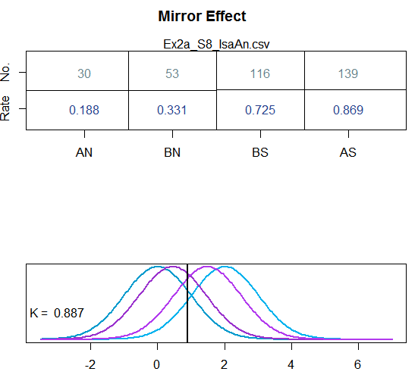

Distributions!

Slide 55



Slide 56



Slide 57



